Slide 1
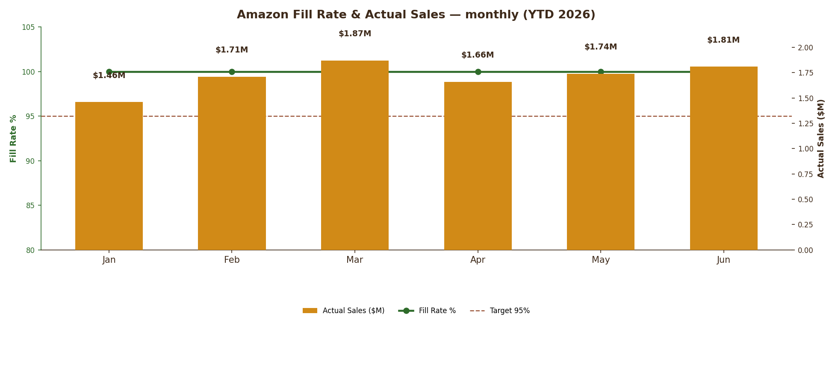
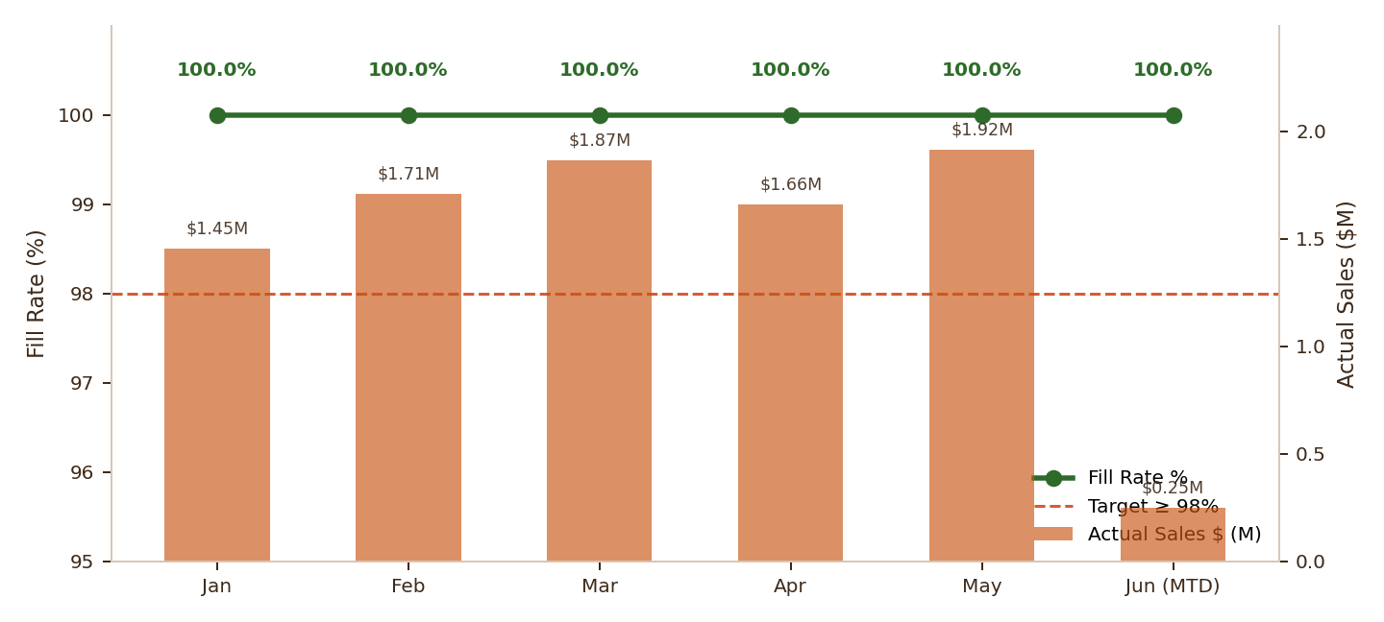
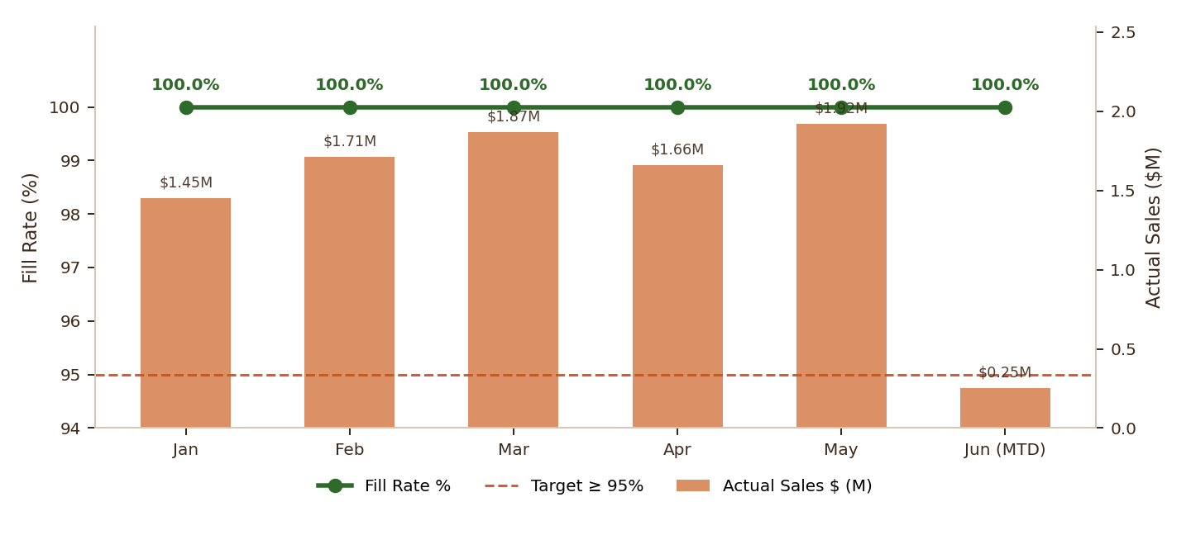
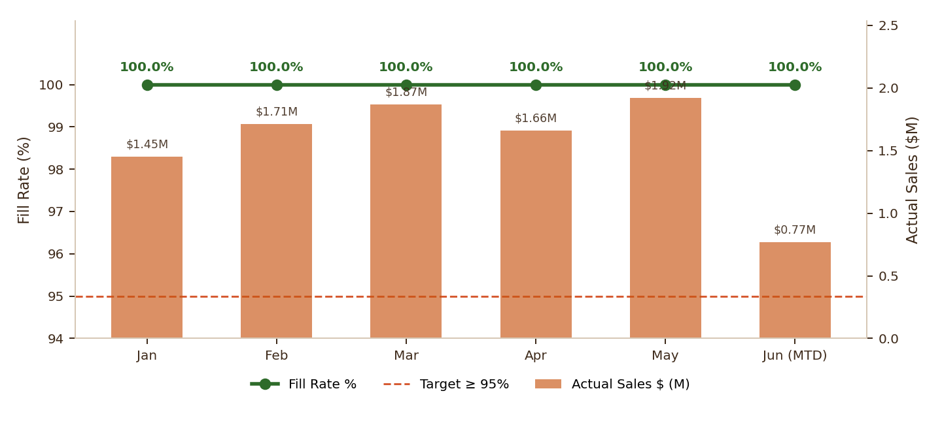
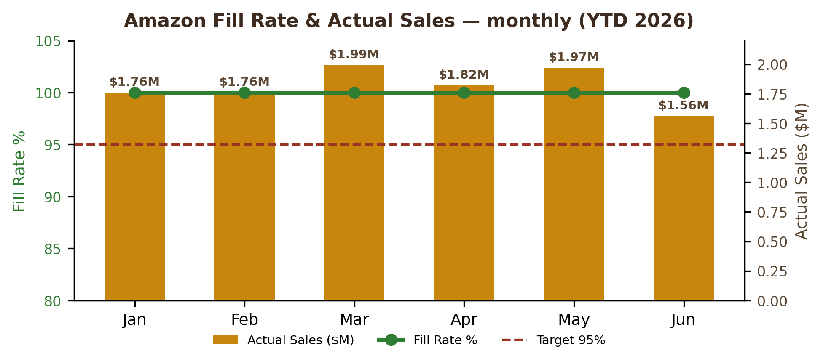
AMAZON FILL RATE & PERFORMANCE REPORT
Wk28 · Updated to July 1, 2026
ON TRACK
June FINAL Fill Rate: 100.0% | Target: ≥ 95% | Actual Sales $1.81M | Lost Sales $0 | Jul MTD (1 day): $40.9K
2026 YTD Fill Rate
2025 Full Year Fill Rate
Last Week (Jun 25 – Jul 1)
SKU WATCH
100.0%
100.0%
100.0%
Crispy Choco PNB · WOS 0.00 | Wafer PKS · WOS 0.02 | Crispy Choco Dubai · WOS 0.05 | Crispy Choco MCH · WOS 0.10 | Crispy Dunes CHH · WOS 0.79 | Romeos Dark Fudge · WOS 1.93 | Crispy Dunes PNB · WOS 1.99 | Nutty Crunch MCP · WOS 2.85 | Crispy Dunes DCH · WOS 4.65 | Leos CNC LS · WOS 5.06 || 10 CRITICAL · 30 MONITOR · 0 STABLE
Jan – Jul 1, 2026 | $10.29M sales | ▬ +0.0 pp WoW
Full-year benchmark reference
Actual Sales $40.9K | Lost Sales $0 ▬ +0.0 pp WoW
AMZ FILL RATE TREND
SKU WATCH
SKU | Status | WOS (weeks) | Action
Crispy Choco PNB |  | 0.00 | Reorder now
Wafer PKS |  | 0.02 | Reorder now
Crispy Choco Dubai |  | 0.05 | Reorder now
Crispy Choco MCH |  | 0.10 | Reorder now
Crispy Dunes CHH |  | 0.79 | Reorder now
Romeos Dark Fudge |  | 1.93 | Reorder now
Crispy Dunes PNB |  | 1.99 | Reorder now
Nutty Crunch MCP |  | 2.85 | Reorder now
NOTE: 6 SKUs flagged "oos" in the Daily P&L; per the Amazon Online KPI formula (Issue=="Out of Stock"), these do not generate lost sales. Sensitivity if counted: June Fill Rate 98.1% (~$37K lost sales). Jun 23-25 promo spike sales already included in June final.
RIP VAN | Amazon Supply Chain | Confidential | Generated July 6, 2026

