Slide 1
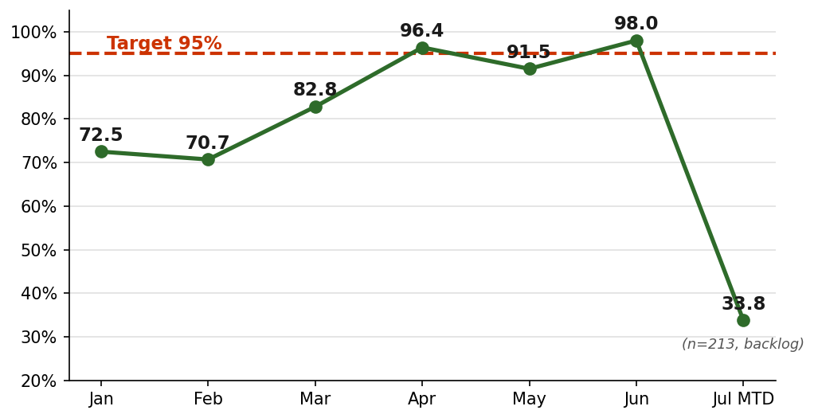
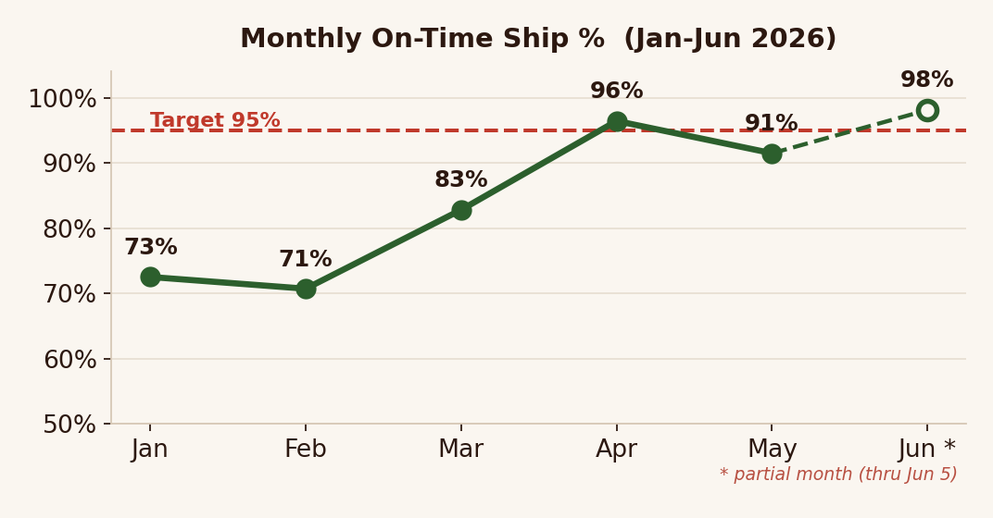
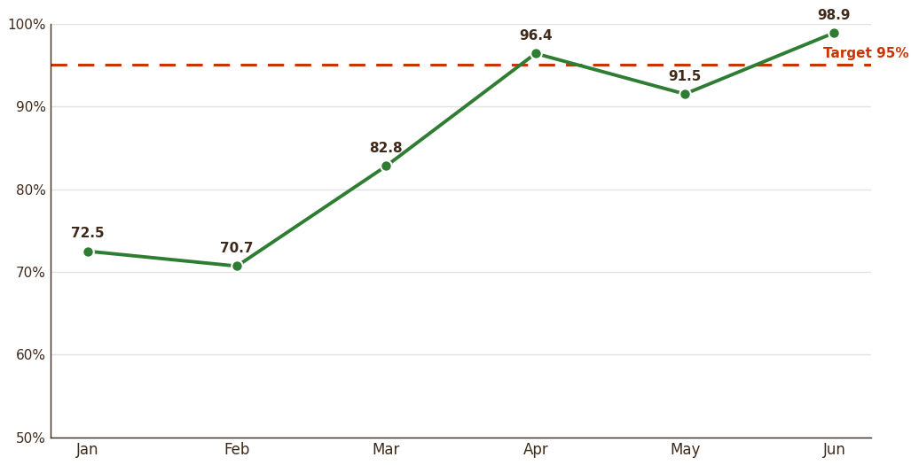
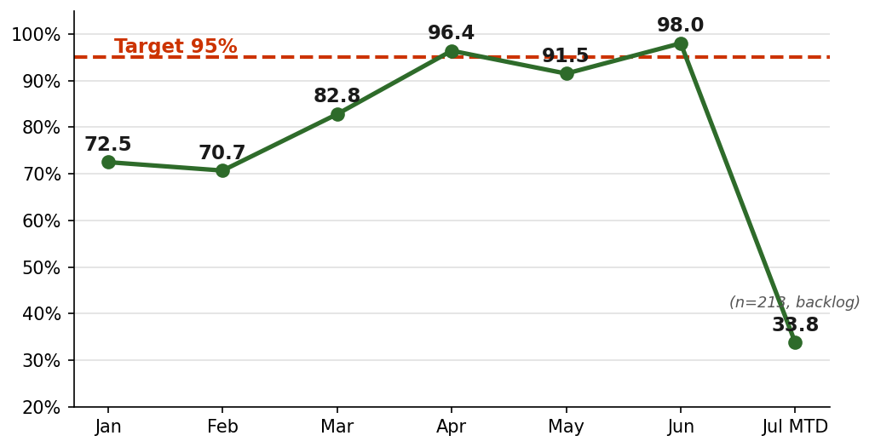
RIP VAN
Week 28 / thru Jul 5 2026
Shopify DTC - On-Time Ship Performance
OFF TRACK
YTD On-Time 82.8% · (was 84.7%) · Target ≥95% | 5-Wk Rolling 85.6% ▼−1.9pp WoW
YTD ON-TIME %
JUN ON-TIME % (final)
BEST MONTH
TARGET
82.8%
98.0%
96.4%
>=95%
YTD ▼−1.9pp WoW
874 / 892 orders
Apr 2026 (complete mos)
On-Time Ship SLA
Monthly On-Time Ship %
5-Week Rolling (Mon-Sun)
Week | Orders | On Time | OTD %
Jun 1-7 | 213 | 209 | 98.1%
Jun 8-14 | 140 | 139 | 99.3%
Jun 15-21 | 182 | 181 | 99.5%
Jun 22-28 | 235 | 234 | 99.6%
Jun 29-Jul 5 | 335 | 183 | 54.6%
Total | 1,105 | 946 | 85.6%
WHAT MOVED — 5-Wk 85.6% (was 99.4%) · YTD ▼−1.9pp WoW
0 despachos el Jun 30 (martes hábil) — el driver real. Jul 3 fue feriado (July 4th observado): el SLA lo trata como no hábil; el WH igual despachó 30 DNs parciales.
152 late en la última semana, la mayoría despachó Jul 2 con 3 días; 63 DNs del finde vencían Jul 6.
CFR qty-fill 97.0% · pending 63 · 1 picked-not-shipped · DN-4037536 COMMIT_BLOCKED 13 días necesita autorización.
CONFIDENTIAL

Slide 2
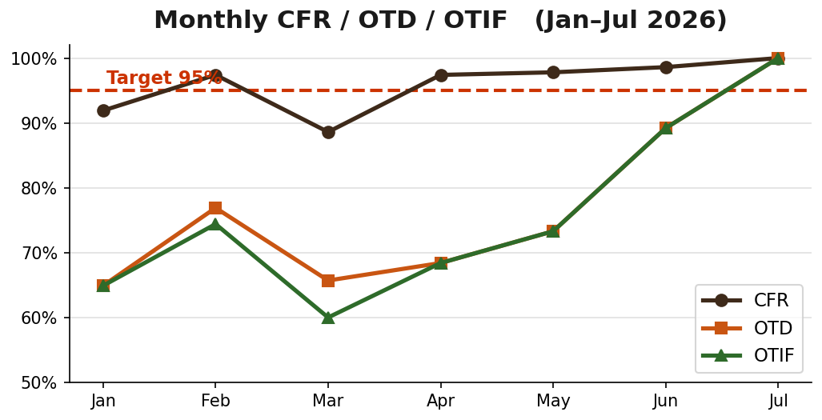
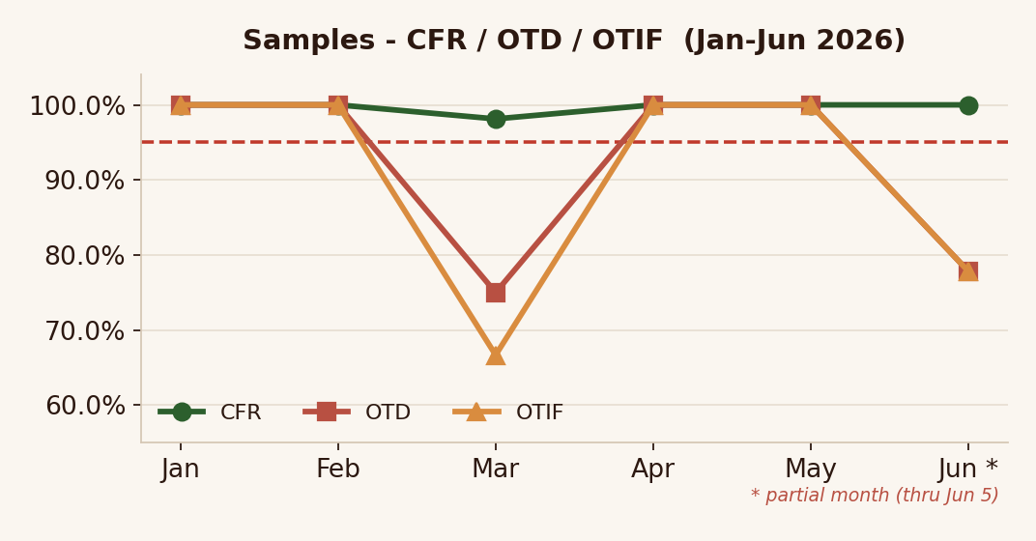
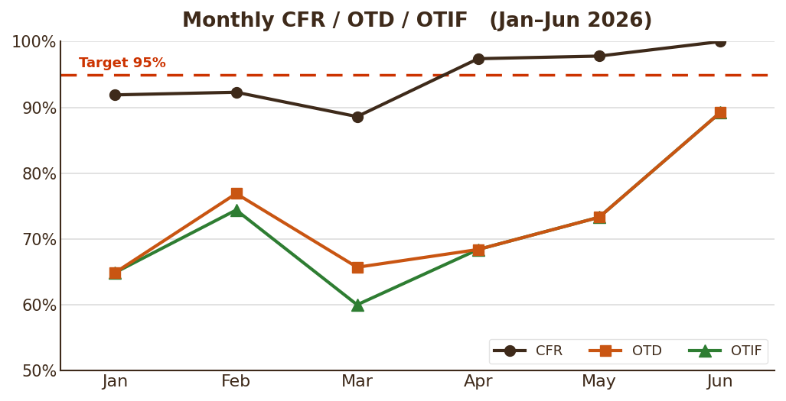
RIP VAN
Week 28 / thru Jul 5 2026
Sales-Team Samples - CFR / OTD / OTIF
OFF TRACK
YTD CFR 96.0% · OTD 75.8% · OTIF 74.7% · 273 assessed (282 req)
YTD CFR
YTD OTD
YTD OTIF
TARGET
96.0%
75.8%
74.7%
>=95%
96.0% in-full
273 assessed / 282 req.
on-time & in-full
CFR / OTD / OTIF
Monthly CFR / OTD / OTIF
Monthly Detail (CFR / OTD / OTIF)
Month | n | CFR | OTD | OTIF
Jan | 37 | 91.9% | 64.9% | 64.9%
Feb | 39 | 97.4% | 76.9% | 74.4%
Mar | 35 | 88.6% | 65.7% | 60.0%
Apr | 38 | 97.4% | 68.4% | 68.4%
May | 45 | 97.8% | 73.3% | 73.3%
Jun | 74 | 98.6% | 89.2% | 89.2%
Jul | 5 | 100.0% | 100.0% | 100.0%
WHAT MOVED — Jun final OTD 89.2% (66/74) · Jul MTD 5/5 · assessed base widened 180→273 (see method note below), so OTD moved from 67.2% to 75.8% on a broader, more accurate sample — not a pure operational gain.
Method note: los 87 pedidos del master sheet ahora matchean a Outbound vía SO# (antes quedaban fuera) — por eso assessed subió de 180 a 273 y OTD de 67.2% a 75.8%; no es mejora operativa pura.
CONFIDENTIAL

