Slide 1
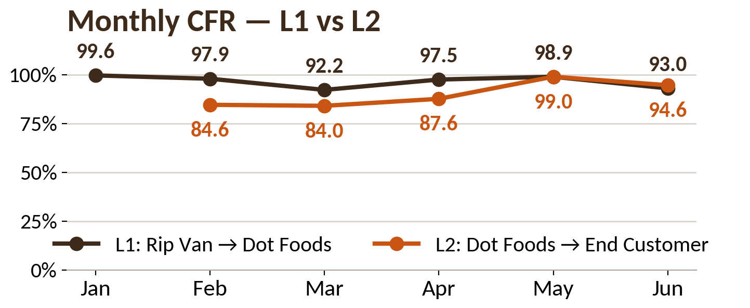
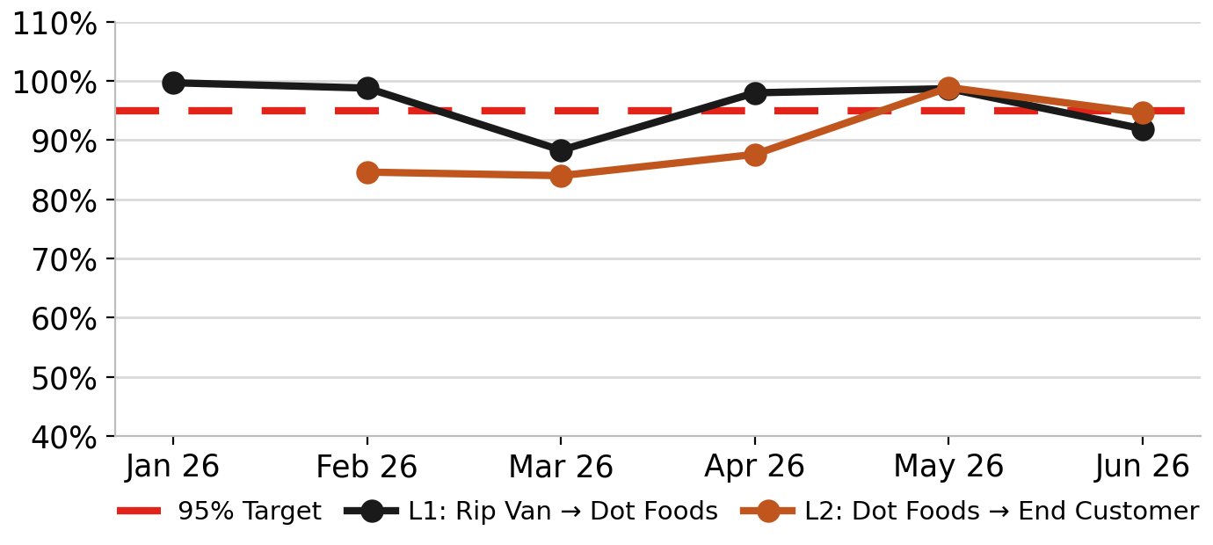
Rip Van | Supply Chain Analytics | Jul 6, 2026
Confidential — Internal Use Only | 1 / 2
Case Fill Rate: Both Levels vs. 95% Target
L1 (Rip Van → Dot Foods) · L2 (Dot Foods → End Customer) | Window: Jan 1 - Jul 5, 2026 (closed months locked) | Target >= 95%
L1 · Rip Van → Dot Foods
L2 · Dot Foods → End Customer
95.7%
58,683
56,173
2,510
88.0%
100,665
88,633
12,032
CFR (JAN-JUN)
EACHES ORDERED
EACHES SHIPPED
EACHES SHORT
CFR (FEB-JUL wk1)
EACHES ORDERED
EACHES RECEIVED
EACHES SHORT
Monthly CFR — L1 vs. L2 vs. 95% Target
Top 5 Worst Customers (L2)
L1: UNIS Outbound by ship date (Dot, shipped lines), Jan-Jun. L2: Sales History thru Jul 5/26 (Feb-May locked; Jun FINAL 94.6%; Jul wk1 97.4% not charted, YTD only). Brown = L1, Orange = L2.
Lowest fill-rate customers, June. Min 100 cs ord.
Customer (Dot DC)
Ord
Recv
Fill %
Vistar – New England
186
155
83.3%
Vistar – Northwest
269
229
85.1%
Vistar – Retail Central
123
112
91.1%
QuikTrip / Belton
207
190
91.8%
Sheetz Distribution NC
103
97
94.2%
Source: L1 CFR now from UNIS "Shipped by Item" (Σ shipped / Σ ordered); prior tracker "case shorted" column under-counted shorts. Order−Shipped Qty by ship date thru Jun 28 2026 (Retailer='DOT FOODS, INC.'). L2 from Rip Van Sales History w/ Usages 6/28/2026 (Wk 14 = Jun 23–28).

Slide 2
Top Offenders — Shorted POs & SKUs (L1) and Worst SKUs (L2)
L1 (Rip Van -> Dot Foods): POs & SKUs shorted (Jan-Jun) . L2 (Dot Foods -> End Customer): worst SKUs by Fill % (Jun) . Window: thru Jul 5, 2026
CFR JAN-JUL L1 / L2
L1 WORST MONTH
L2 WORST OFFENDER
L1 TOP SHORT SKU
95.7% / 88.0%
Mar 26
0.0%
Wafer VNL 4x12ct TANDE
L1 on track . L2 recovering (Jun FINAL 94.6%)
88.3% — see L1 monthly
Wafel Shipper 48-48ct
Short 1,003 ea
L1 — Shorted POs (Rip Van → Dot Foods)
L2 — Top 10 Worst SKUs by Fill % (Dot Foods → End Customer)
UNIS Outbound, by ship date. Σ short all Dot POs = 2,510 ea (Fill 95.7%, ties L1 KPI 95.7%).
Sales History thru 7/5/26 (June figures). Ranked ascending. Red = sub-95%. Min 100 cs ordered where available.
PO #
Ship-To · Date
Ord
Short
Fill %
SKU
Description
Ord
Recv
Sh
Fill %
522076-001
Mt. Sterling · 3/30
3,244
1,003
69.1%
—
WAFEL SHIPPER 48 - 48 CNT
169
0
169
0.0%
527687-001
Mt. Sterling · 3/31
2,287
302
86.8%
584326-001
Mt. Sterling · 6/15
1,307
281
78.5%
—
STRAWBERRY WAFER 4 - 32 -
95
22
73
23.2%
510487-001
University Park · 3/12
660
180
72.7%
—
CHOCOLATE HAZELNUT CRISPY DUNE
806
792
14
98.3%
596253-001
Mt. Sterling · 6/23
1,261
141
88.8%
—
LS SNICKERDOODLE WAFELS 4 -
112
30
82
26.8%
—
—
—
—
Σ POs (thru Jun 28)
58,683
2,510
95.7%
—
CHOCOLATE BROWNIE WAFELS 4 - 1
102
101
1
99.0%
L1 — SKUs Shorted to Dot (UNIS Outbound)
—
HONEY & OATS WAFELS 4 - 12 - 1
1,095
1,089
6
99.5%
UNIS Outbound by-product short. Σ short = 2,510 ea (ties PO table & L1 KPI 95.7%).
—
CHOCOLATE HAZELNUT WAFER 4 - 1
226
225
1
99.6%
SKU
Description
Ord
Ship
Short
5032
Wafer VNL 4x12ct TANDEM 1.56 o
4,191
3,188
1,003
—
COOKIES & CREAM WAFELS 4 - 12
373
372
1
99.7%
8802
Crispy Dunes CHH 4 x 12ct 1.1
2,107
1,619
488
—
DUTCH CARAMEL & VANILLA WAFELS
3,180
3,173
7
99.8%
0009
Leos CNC 4 x 10 CT LS 1.69oz
980
551
429
3341
Wafel DCV 4 x 12 CT 1.16oz
7,680
7,520
160
—
DUTCH CARAMEL & VANILLA WAFELS
280
280
0
100.0%
3881-N
Wafel CNC 4 x 12 CT 1.16oz N
1,500
1,365
135
Σ SKUs
thru Jun 28
58,683
56,173
2,510
Source: L1 (headline, POs and by-SKU short) from UNIS Outbound (Retailer='DOT FOODS, INC.', Order-Shipped Qty, shipped lines, by ship date thru Jun 28 2026). L2 from Rip Van Sales History thru Jul 5, 2026.
Rip Van | Supply Chain Analytics | Jul 6, 2026 Confidential - Internal Use Only 2 / 2

