Slide 1
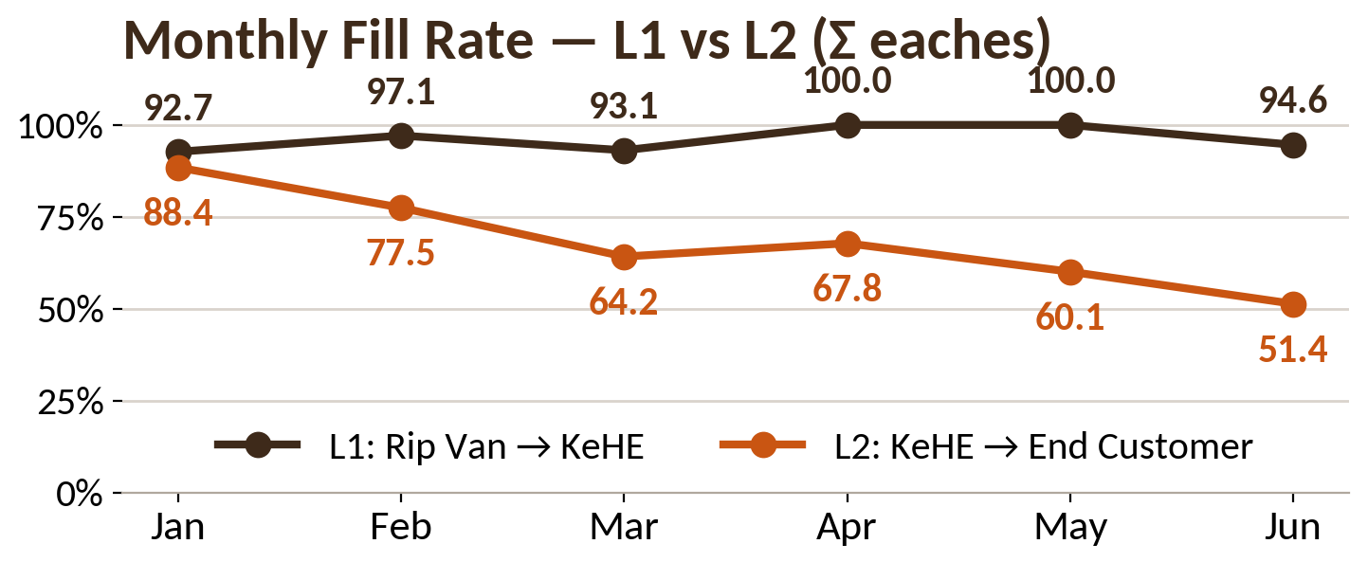
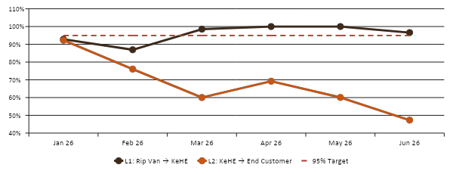
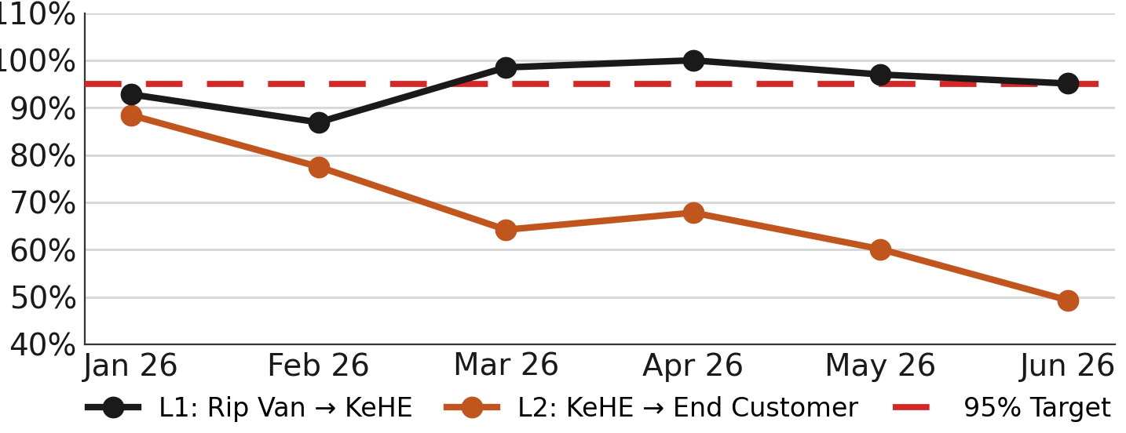
Rip Van | Supply Chain Analytics | Updated Jul 6, 2026
Confidential — Internal Use Only | 1 / 1
Case Fill Rate: Both Levels vs. 95% Target
L1 (Rip Van → KeHE) · L2 (KeHE → End Customer) | Window: Jan 1 – Jul 5, 2026 | Target ≥ 95%
L1 · Rip Van → KeHE
L2 · KeHE → End Customer
96.2%
94.6%
100.0%
+1.2 pts
59.9%
51.4%
-8.7 pts
-35.1 pts
CFR (JAN-JUL)
JUN CFR (FINAL)
MAY CFR
VS 95% TARGET
CFR (JAN-JUL)
JUN CFR (FINAL)
MoM vs MAY
VS 95% TARGET
Monthly Fill Rate — L1 vs. L2 vs. 95% Target
Top 5 Worst Retailers (L2) — June 2026 (FINAL)
L2 falls to 51.4% in June (FINAL); Kroger 40.9% (67% of volume) & Hungryroot 43.5% drive it. YTD 59.9% uses portal volumes; Jan–May bars locked.
Lowest fill-rate retailers, Jun 1–30, 2026 (eaches). All five below 95% target.
Customer
Ord
Shipped
Fill %
Kroger
93,810
38,340
40.9%
Hungryroot
8,136
3,540
43.5%
CVS
6,048
2,160
35.7%
All Other
4,734
2,790
58.9%
Single-Store Retailers
588
450
76.5%
Sources: L1 from Outbound-Inquiry-Expanding (Jul 5, 2026 — SHIPPED + SHORT_SHIPPED only, Retailer = Kehe; Σ shipped / Σ ordered), Jan 1–Jul 5 2026. L2 from KeHE CONNECT “Chains & Stores that ordered an Item” (KeHE_RN0048_VC; Jun = Jun 1–30 FINAL, YTD = Jan 1–Jul 5 2026, in eaches). CFR = Shipped / Ordered. Jan–May monthly bars locked (portal later restated Mar–May to 60.6/59.7/56.7; YTD % uses current portal volumes). HEB 98.6% (12,494 ea) shown as positive contrast, not in worst-5.

