Slide 1
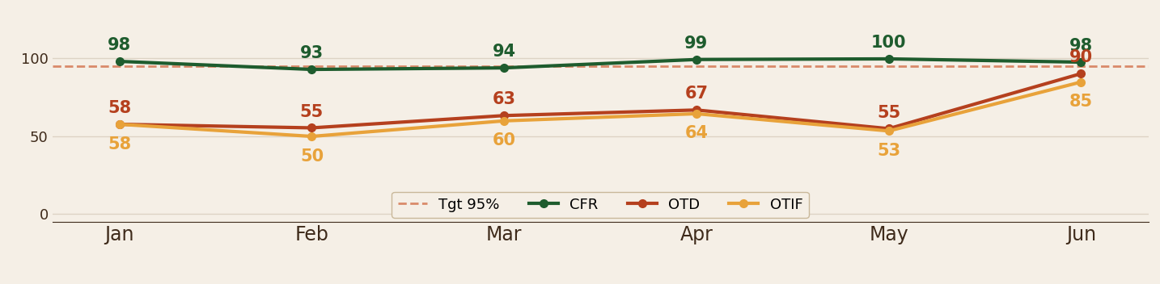
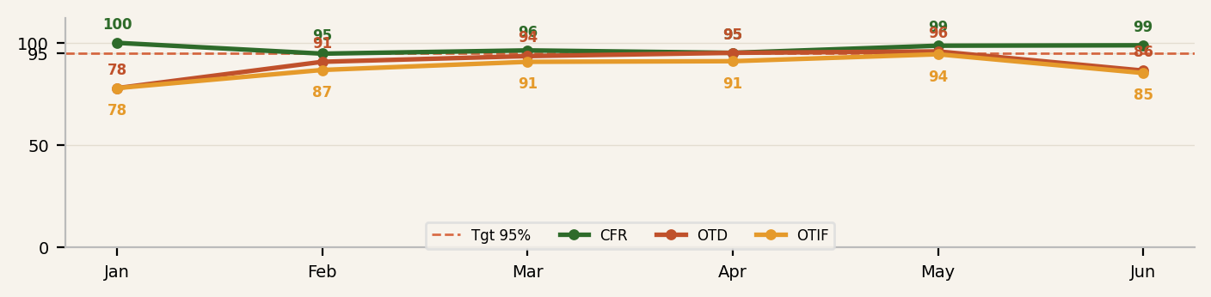
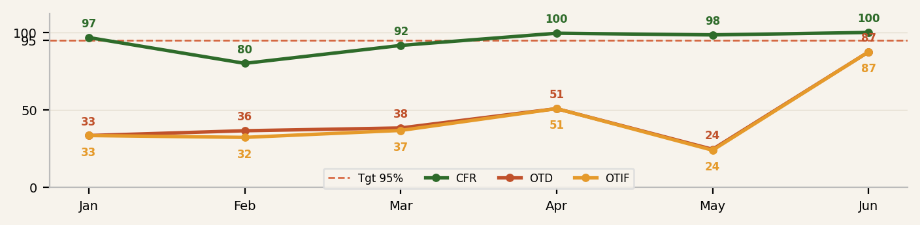
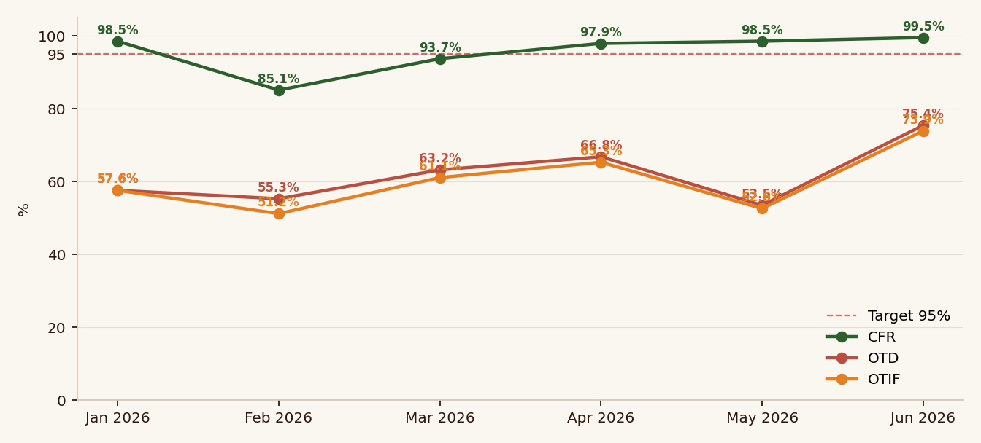
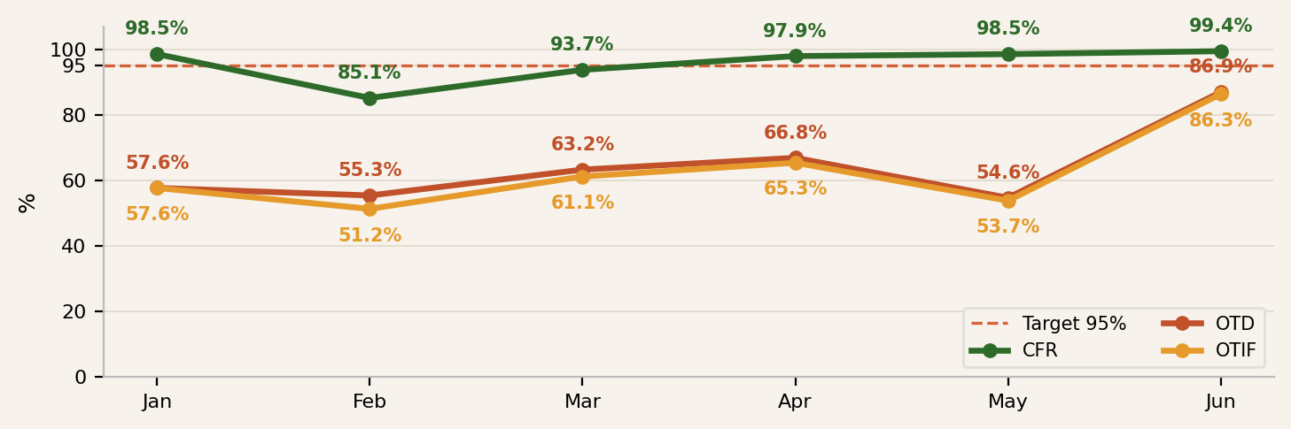
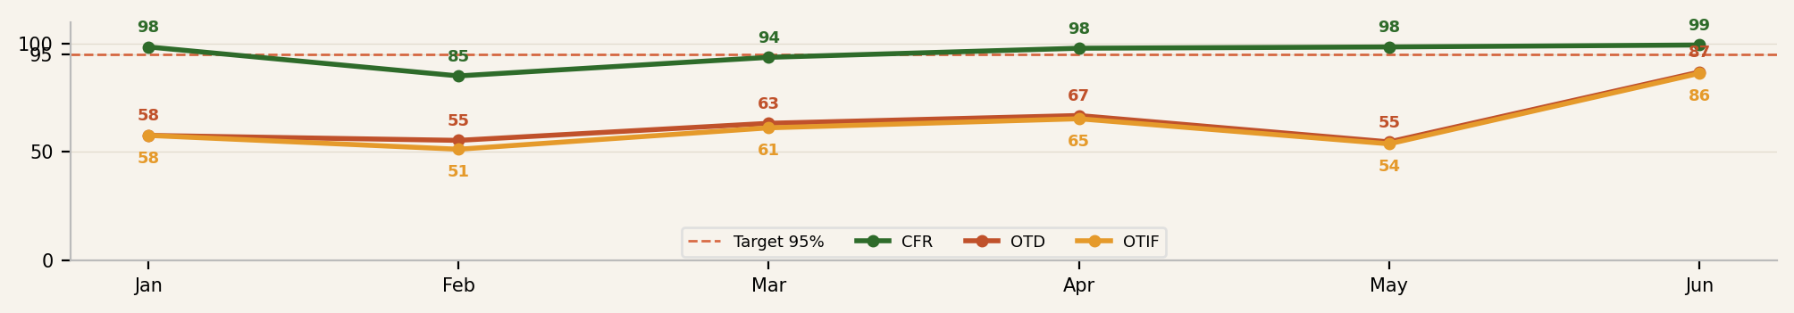
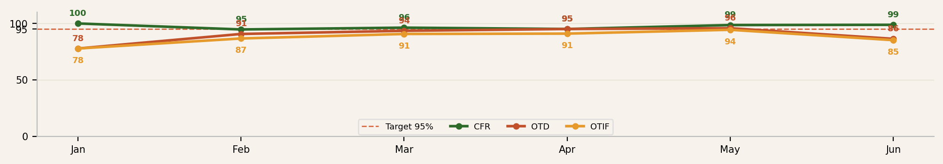
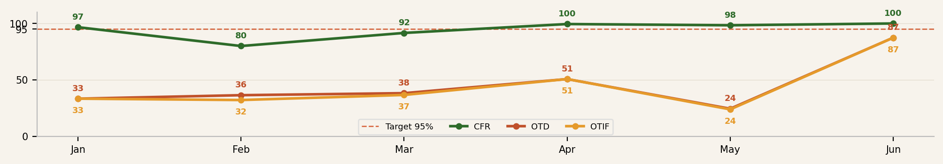
RIP VAN
B2B Customer Service — KPI Performance (CFR · OTD · OTIF)
YTD Jan – July 5, 2026
OVERALL — All Channels • YTD 1,512 orders • Target ≥95%
CFR
96.8%
COMMENTS
• June FINAL: OTD 90.2%, OTIF 84.8% (vs 91.0/89.4 read Jun 29)
• Combined OTIF 62.3% YTD, -1.4pp WoW on UNFI pickup delays
• Jul MTD thin (22 POs); penalty-rule pending actuals, don't read yet
Overall CFR = volume fill rate from UNIS Shipped-by-Item (Sigma shipped / ordered), named distributors; carrier/pickup CFR shown are order-level (PO-in-full). OTD/OTIF are PO-level.
OTD
65.8%
OTIF
62.3%
CARRIER DELIVERIES (623) • Required vs Actual Delivery
CFR
93.6%
COMMENTS
• In-full 93.6% YTD, OTD 92.8%, OTIF 87.3% (was 96.9/93.1/90.5)
• June close: carrier shorts landed late, pulling OTIF vs Jun 29 read
• Wk27 5-wk OTD 77.3%, OTIF 68.2% — lowest of last 5 weeks
OTD
92.8%
OTIF
87.3%
CUSTOMER PICKUP (889) • Required vs Actual Pickup
CFR
92.5%
COMMENTS
• Target 546 POs: 100.0% in-full, 51.1% OTD/OTIF
• UNFI 268 POs: 85.1% in-full, 44.0% OTD, 40.3% OTIF — 11 of 16 Wk27 POs late
• 13 UNFI pickups overdue uncollected (4 since Jun 25); Dot 47 POs at 55.3/31.9/14.9
OTD
46.9%
OTIF
44.8%
CONFIDENTIAL — INTERNAL USE ONLY
1

